Slide 1

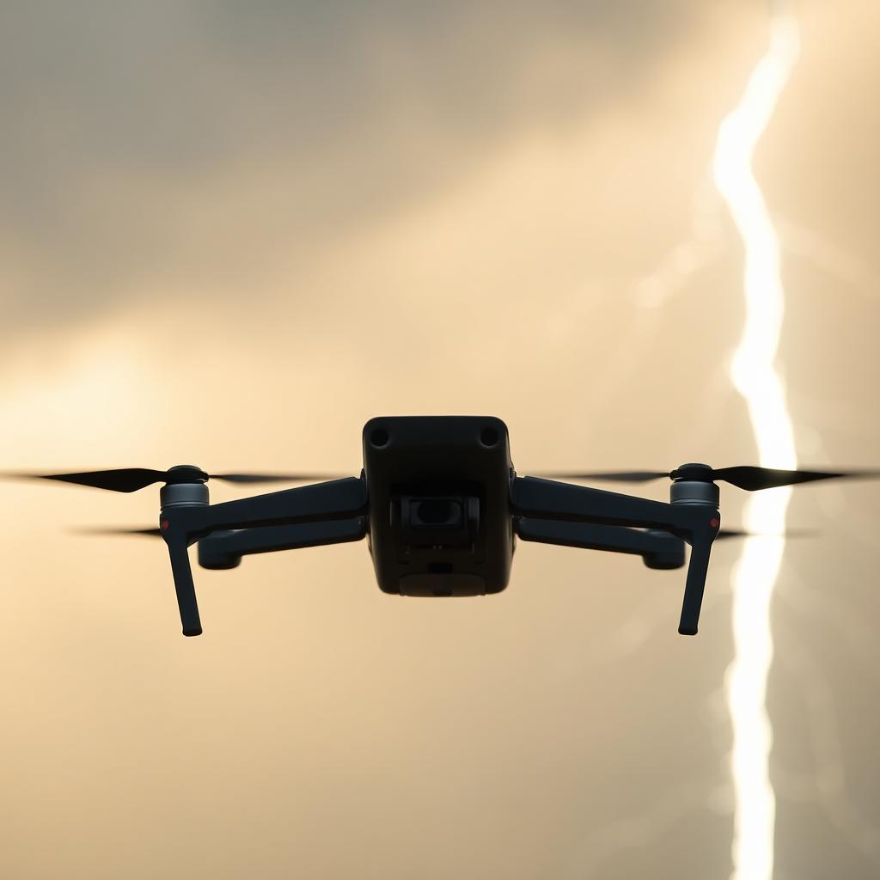
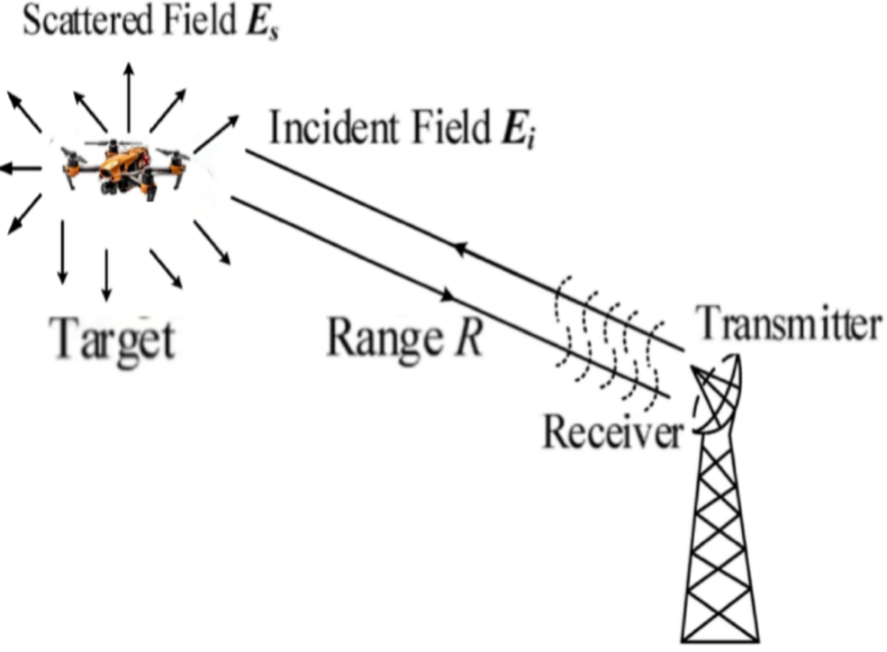
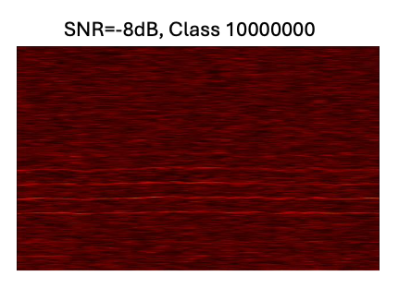
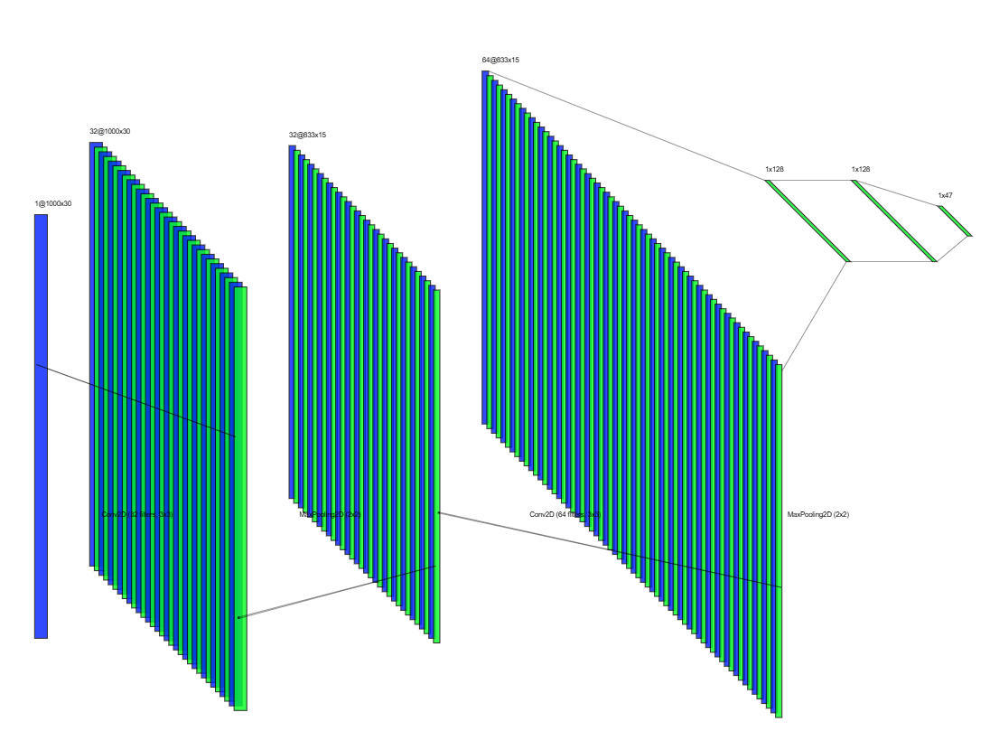
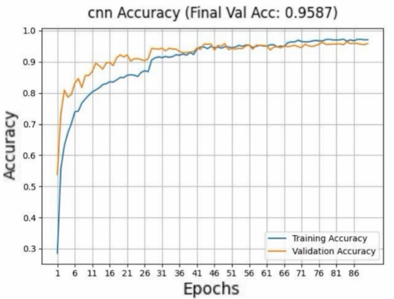
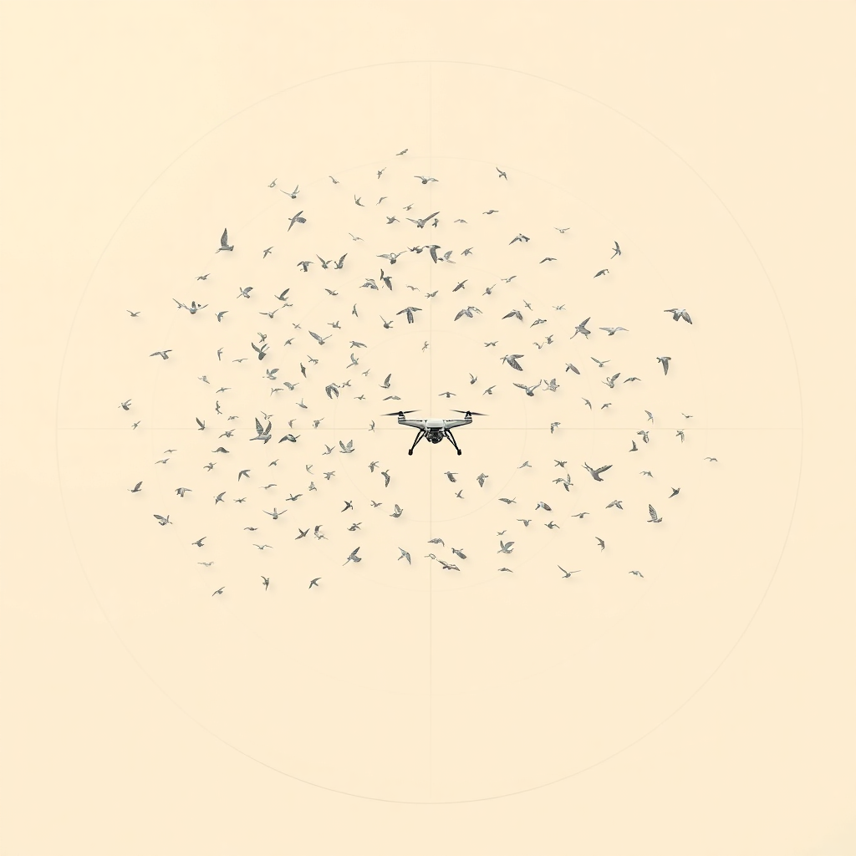

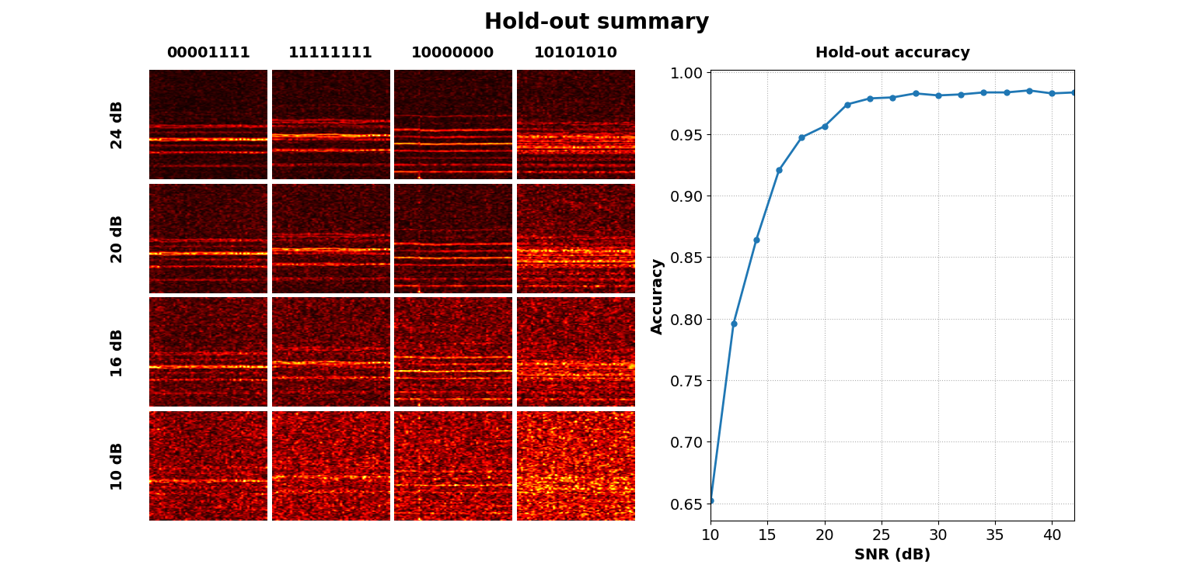
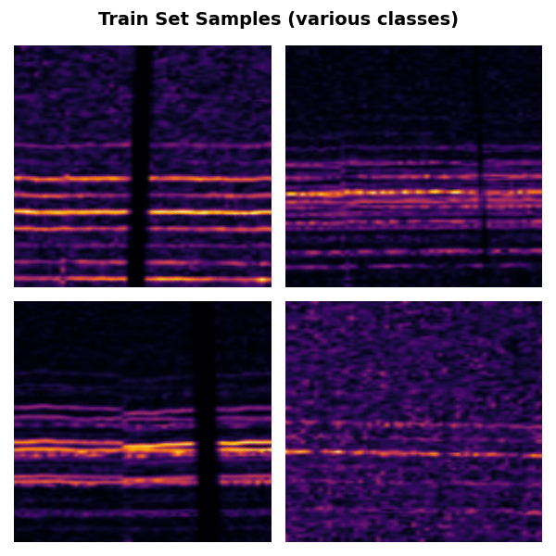
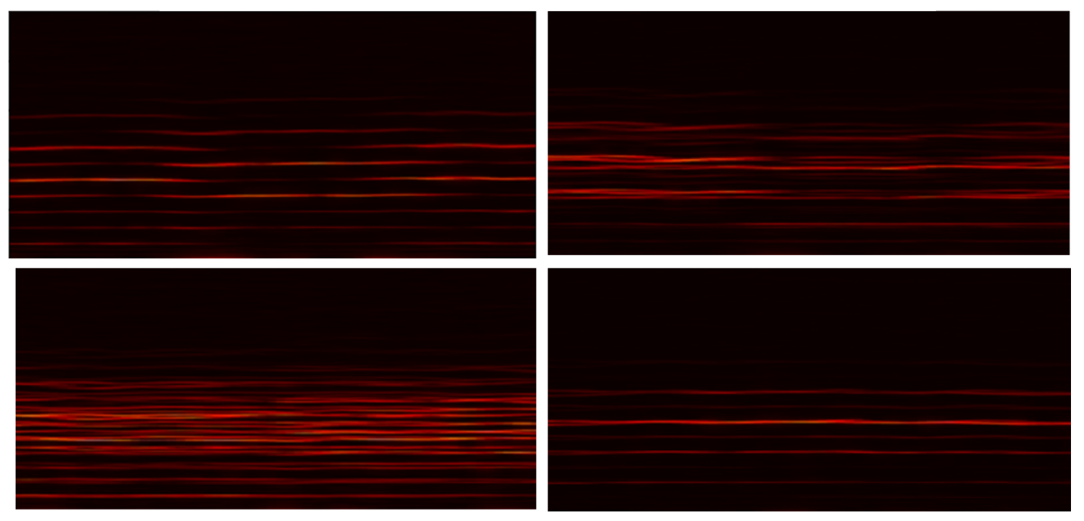
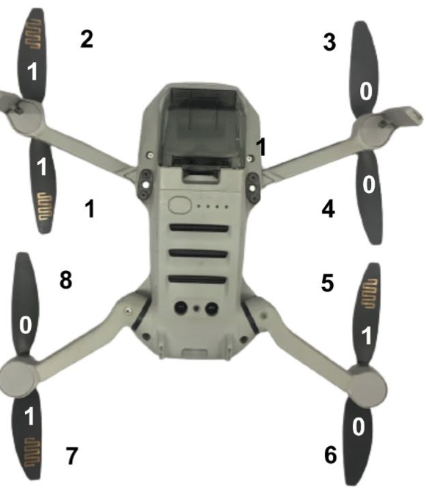
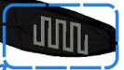
Drone Identification Using Micro-Doppler
Project Number: 24-1-1-3174
Names: Amit Stein, Niv Avivi
Supervisor: Omer Tzidki
Motivation Growing drone use demands detection Beyond optical/thermal limits- in bad weather, urban clutter, or among other UAVs. A TAU Radar Lab study showed that arranging dipole tags on rotor blades yields unique 8-bit micro-Doppler codes. This method leverages enhanced Scattering to overcome low RCS and reliably identify individual drones under all conditions. Introduction In our project, we implement the Classifier component of this research, using measured micro-Doppler signatures. Our objective is to accurately classify noisy micro-Doppler signals at low SNRs ratios. To achieve this, we employ a convolutional neural network (CNN) trained with a synthetic data pipeline and extensive augmentation, demonstrating the robustness of our approach in noisy SNR environments. | Implementation We were given six 10-second signals (50 001 complex samples) for each of 34 tag configurations indoors. Segmentation & shifts: Split each signal into 7,700-sample segments with 50 % overlap and From each segment, generate seven time-shifted versions (plus the original). Spectrogram & split: Compute a normalized STFT (256-sample Hann window, 50 % overlap) and stratify into 70 % train, 20 % validation, 10 % hold-out. Augmentation & noise: Train: random affine (±4°/±10 %) + time-masking + Gaussian noise (0-32 dB SNR). Val: mild affine (±1°/±2 %), no mask, noise 0-32 dB. Hold-out sets: From the 10 % split, we created separate dataset files at fixed SNRs. Training dataset augmentations of segements CNN Model We used three convolutional layers with 32, 64, and 128 filters, each followed by a ReLU activation and a 2×2 max-pooling layer. In the head, we applied dropout and a fully connected layer ending with a softmax activation. | Results & Conclusions Peak Validation Performance After extensive hyperparameter tuning and repeated training runs, our CNN reached its highest validation accuracy at 90 epochs, with both training and validation curves nearly overlapping. This close alignment indicates excellent generalization and minima overfitting. CNN Validation Accuracy Across Datasets with Fixed SNR Levels The accuracy curve demonstrates that our classifier exceeds 90 % once the SNR reaches 15 dB, and climbs to 97 % at 24 dB and above. Bibliography D. Vovchuk, M. Khobzei, V. Tkach, O. Eliiashiv, O. Tzidki, K. Grotov, A. Glam, and P. Ginzburg, “Micro-Doppler-Coded Drone Identification,” arXiv:2402.04368, Feb. 2024.
Project Block Scheme
CNN Classifier
10000000
Micro-doppler analysis
10000000
C/D
Class Number
Spectograms for different microdopler signitures
Example of a drone from class 11001010
10000000
11111111
10000000
11111111
10101010
00001111
10101010
00001111
The dipole tag

